Slide 1
BBA in AVIATION MANAGEMENT College of Management & Commerce SRINIVAS UNIVERSITY Mangalore – INDIA Visit blog: srinivasuniversitybbaaviation.blogspot.com

Slide 3
AVIATION STUDENTS VISIT TO KANNUR AIRPORT

Slide 5
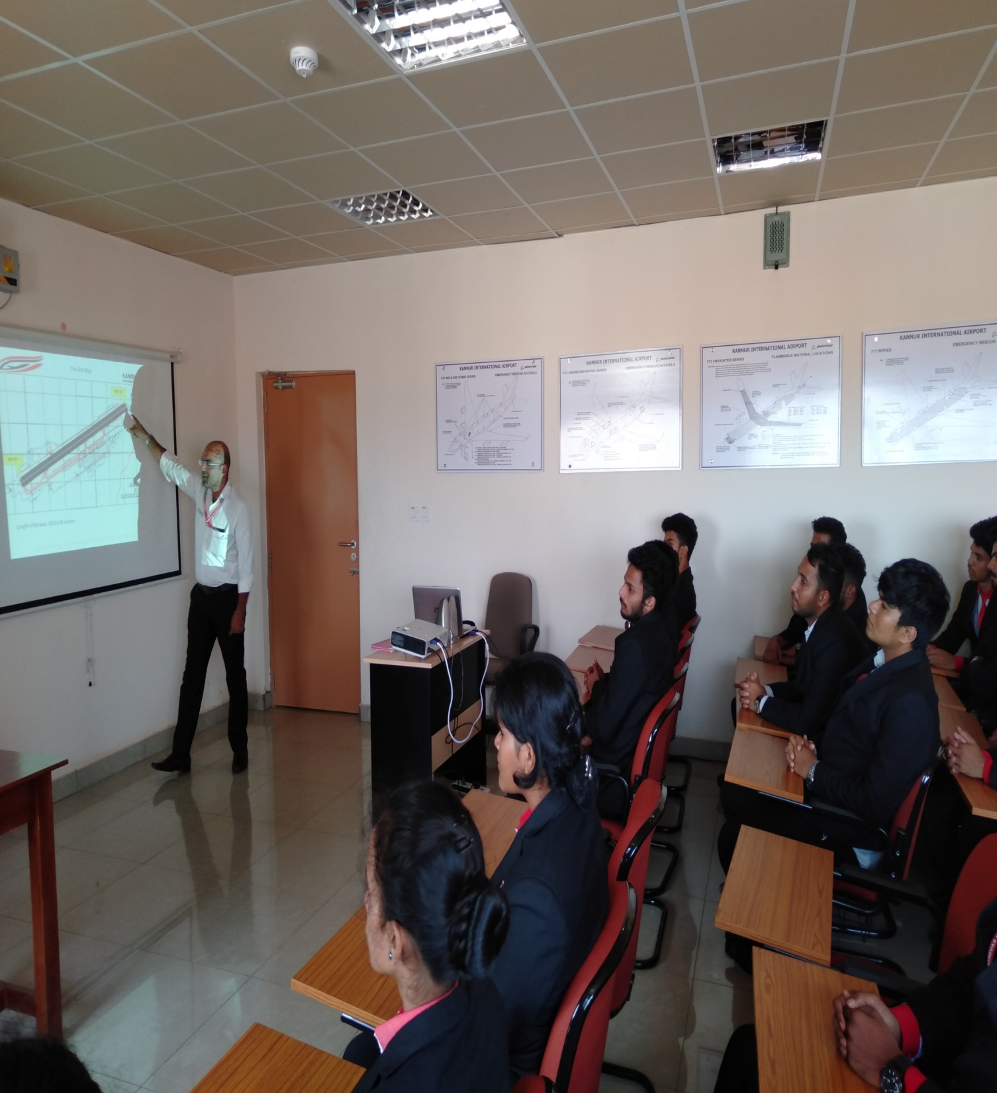

Slide 6
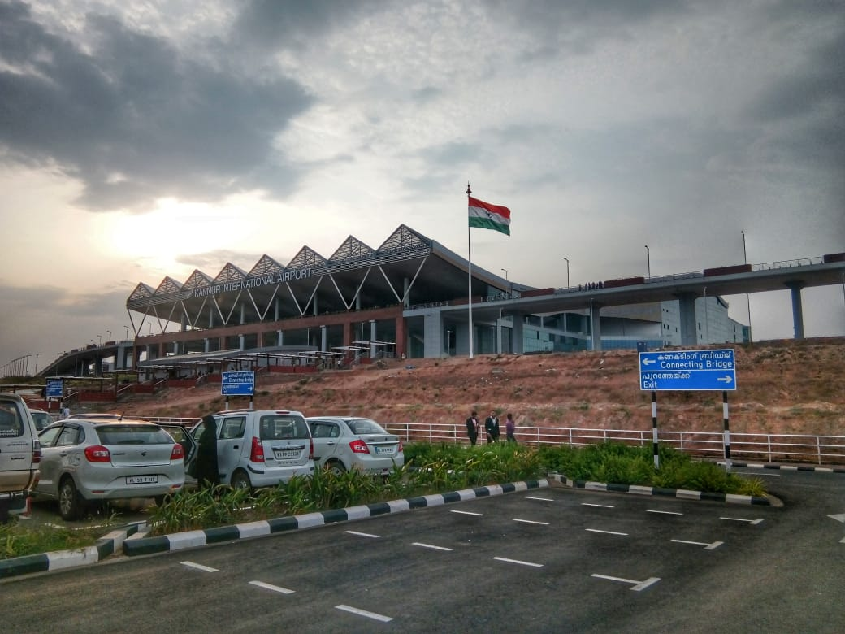

Slide 7
GEJJE POOJE – START UP FOR BHARATHANATYAM CLASS

Slide 11
FRESHERS DAY

Slide 12
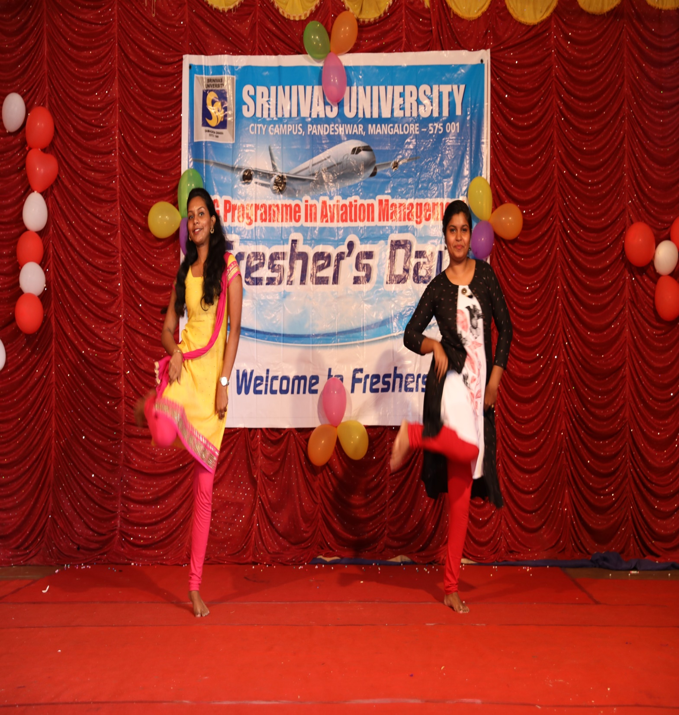

Slide 13
DHAANOSTHAV

Slide 15
CARROM COMPETITION

Slide 17
DENTAL CAMP AT CAMPUS

Slide 20
FACE PAINTING COMPETITION

Slide 21
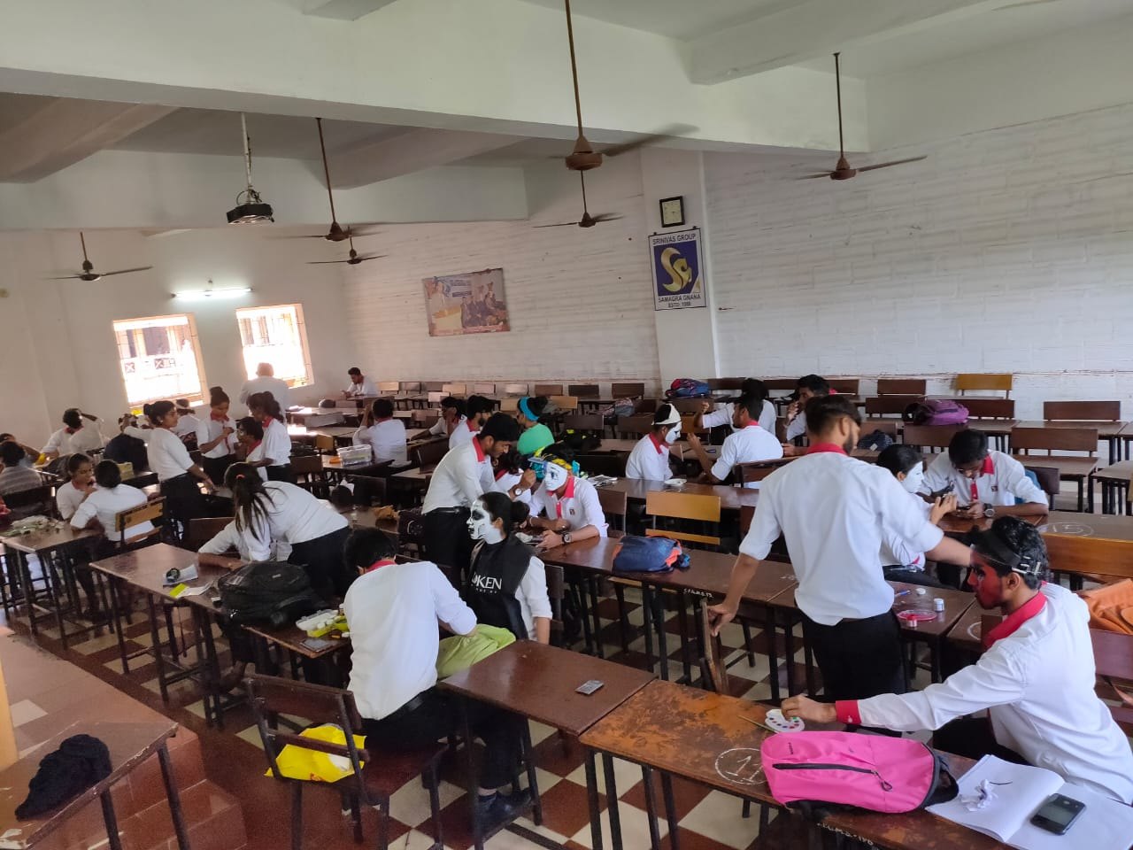

Slide 22
CHESS COMPETITION

Slide 23
FIRE SAFETY MOCK DRILL

Slide 24
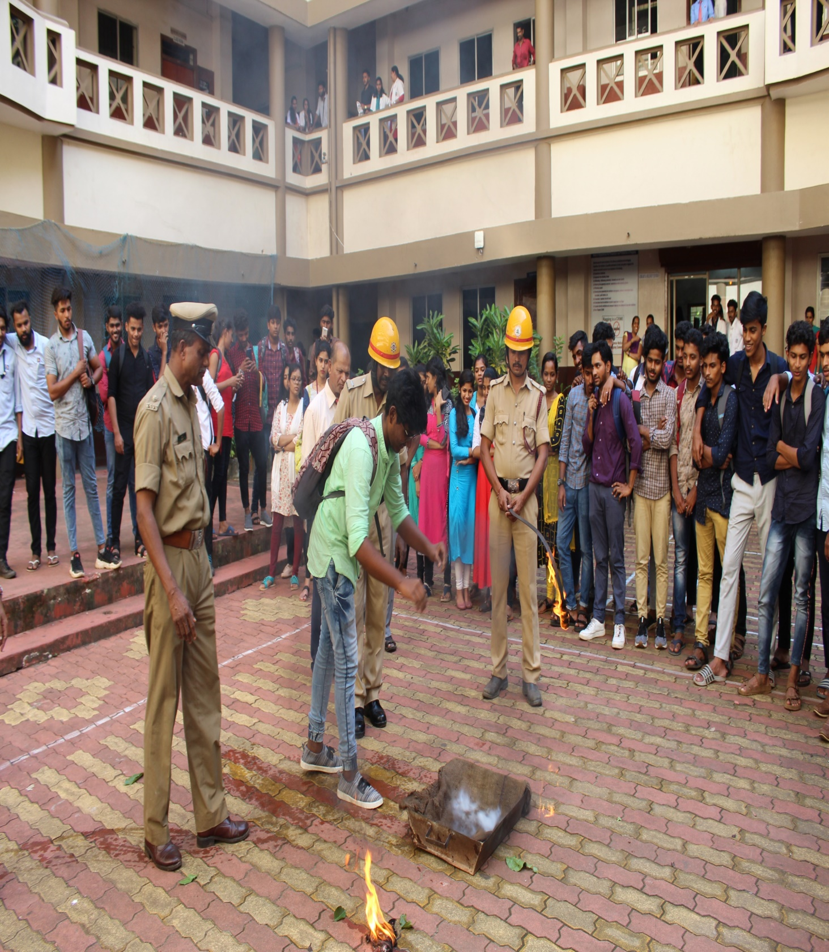

Slide 26
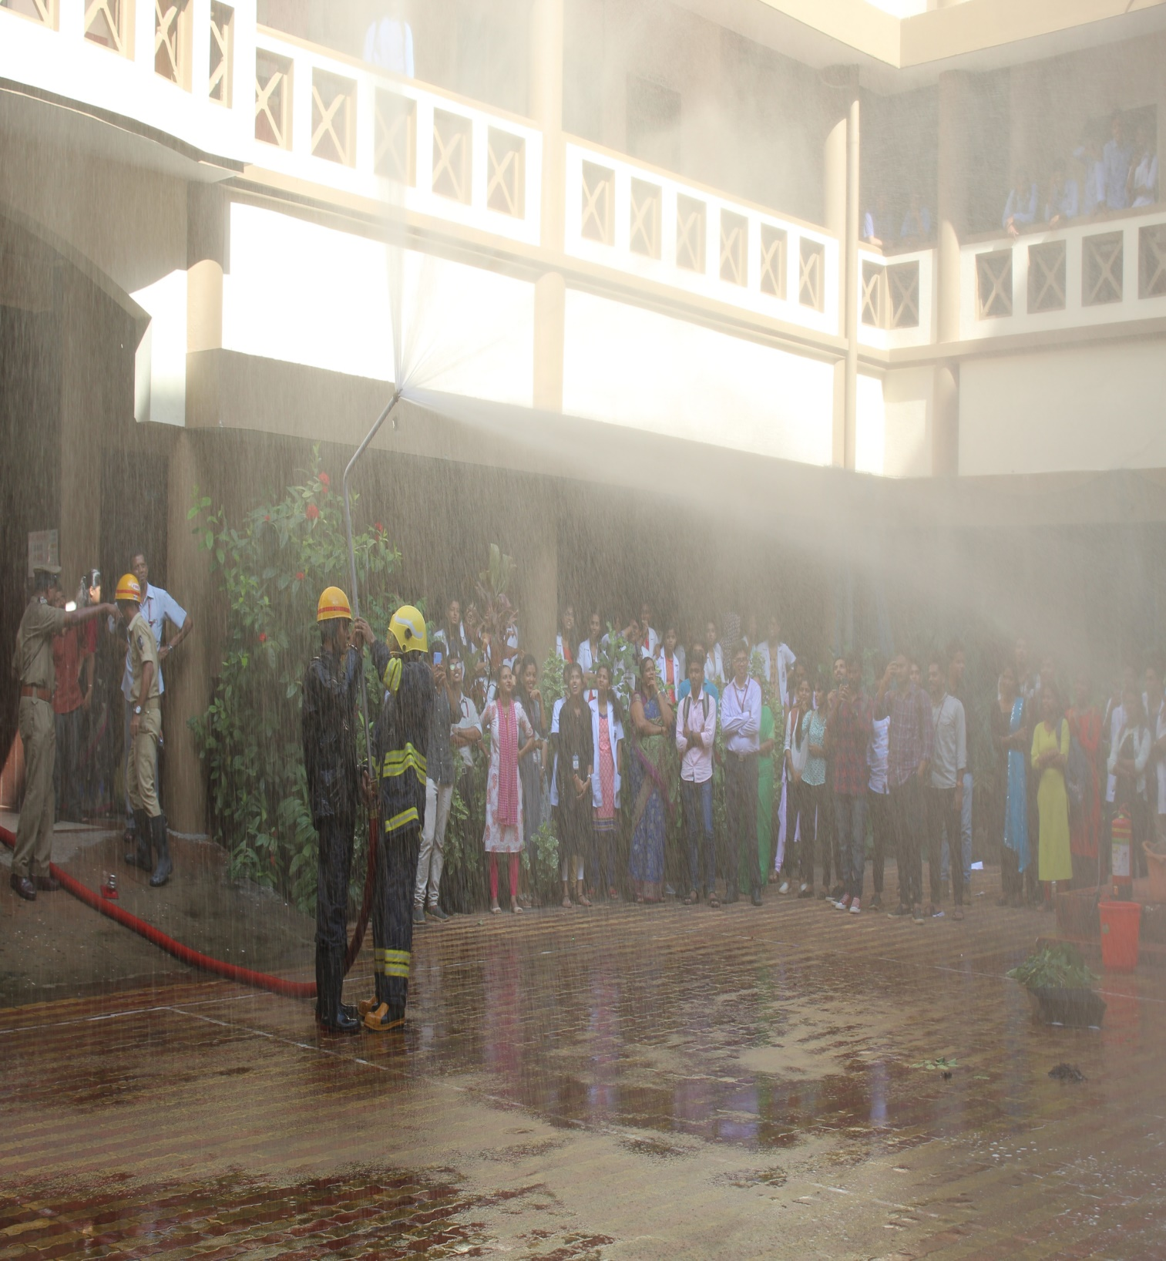

Slide 27
GUEST LECTURE ON GROUND HANDLING AND BAGGAGE HANDLING

Slide 28
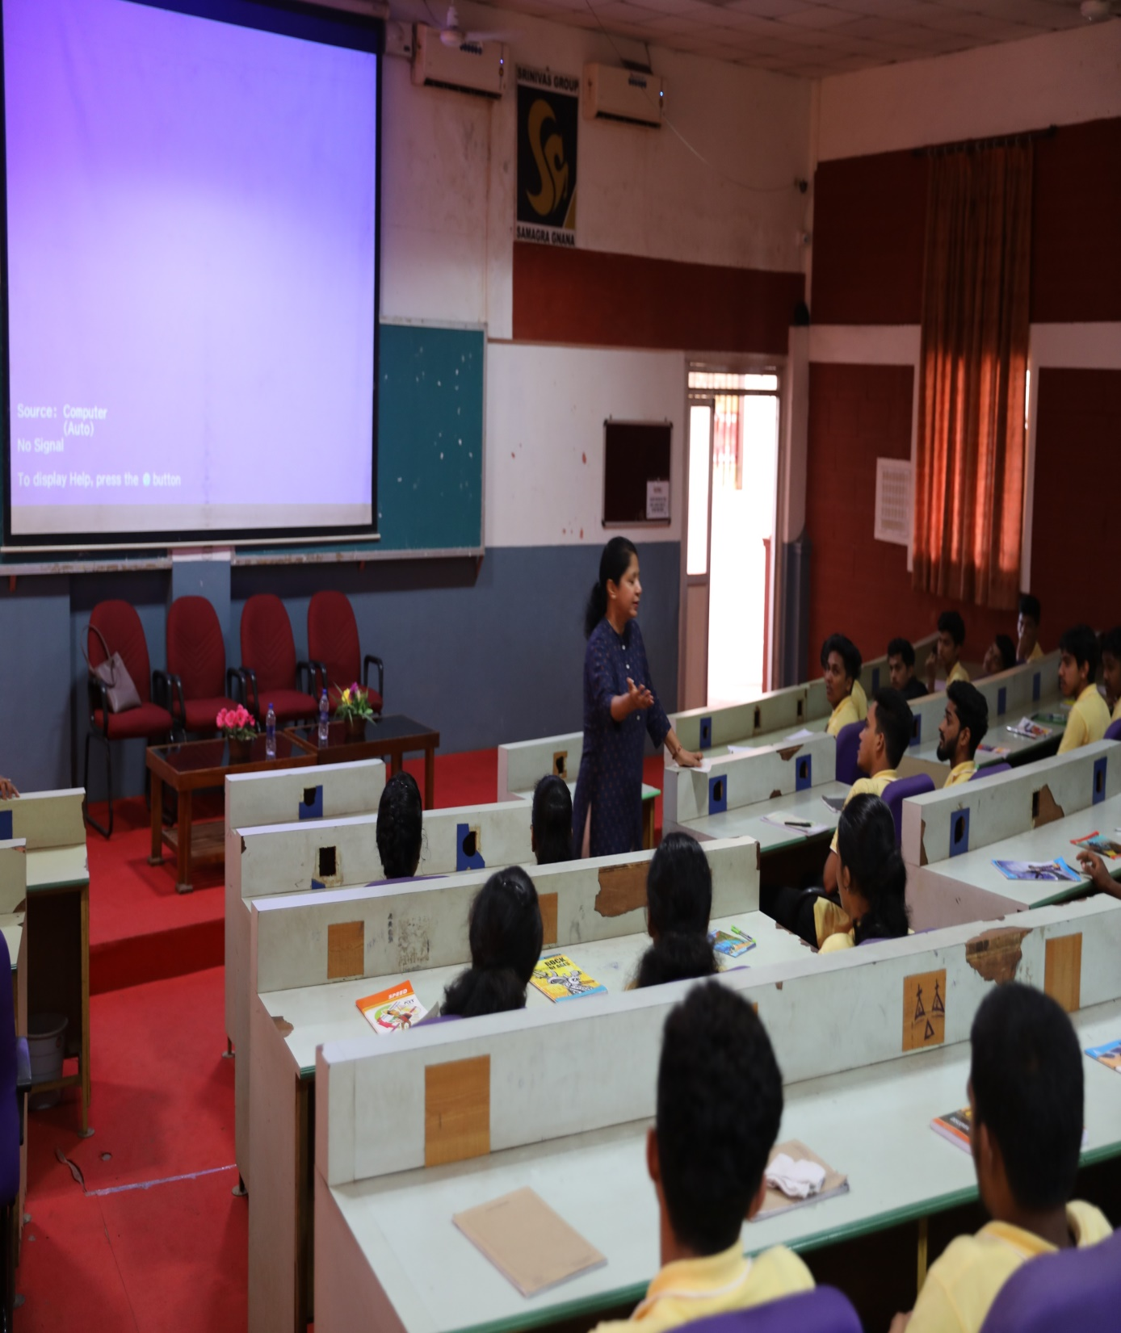

Slide 29
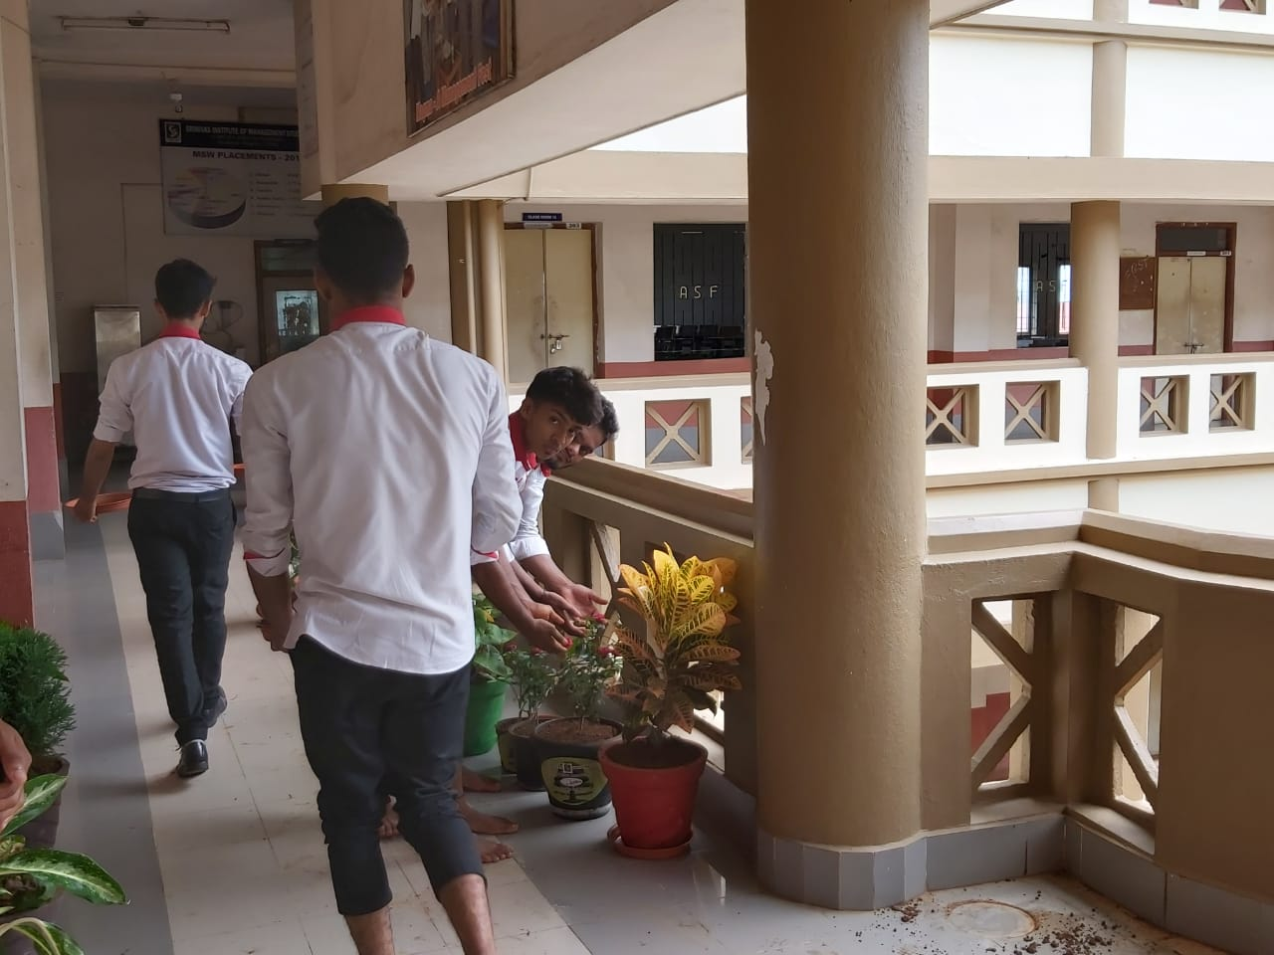
GO GREEN CAMPUS- PLANT MAINTENANCE

Slide 30
PLACEMENT AS CABIN CREW IN INDIGO AIRLINES

Slide 31
GUEST LECTURE ON AVIATION SAFETY

Slide 32
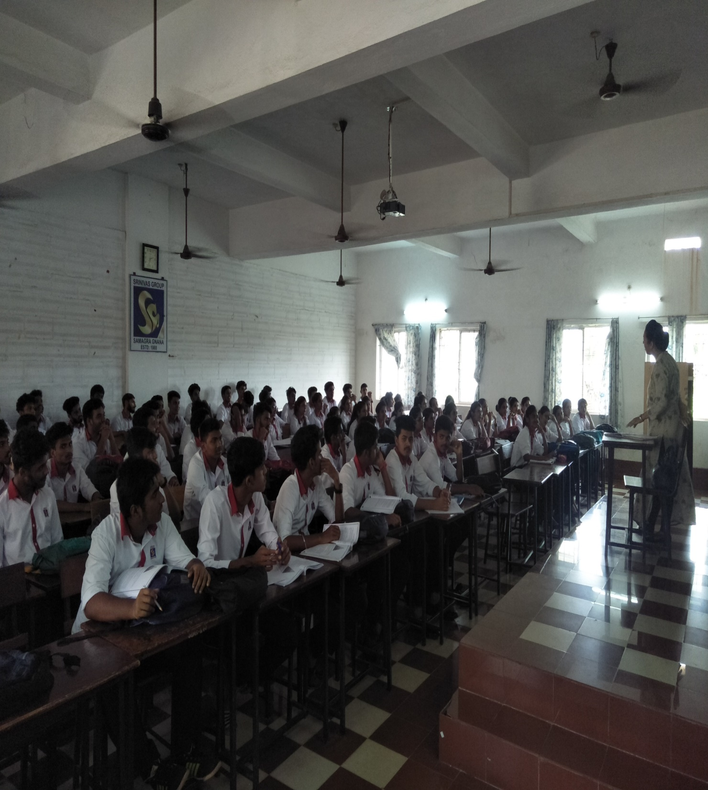

Slide 33
INTERNATIONAL YOUTH DAY – WINNERS OF ROLE PALY

Slide 35
INTERNATIONAL YOUTH DAY – WINNERS OF COLLAGE

Slide 37
MEHANDI COMPETITION

Slide 38
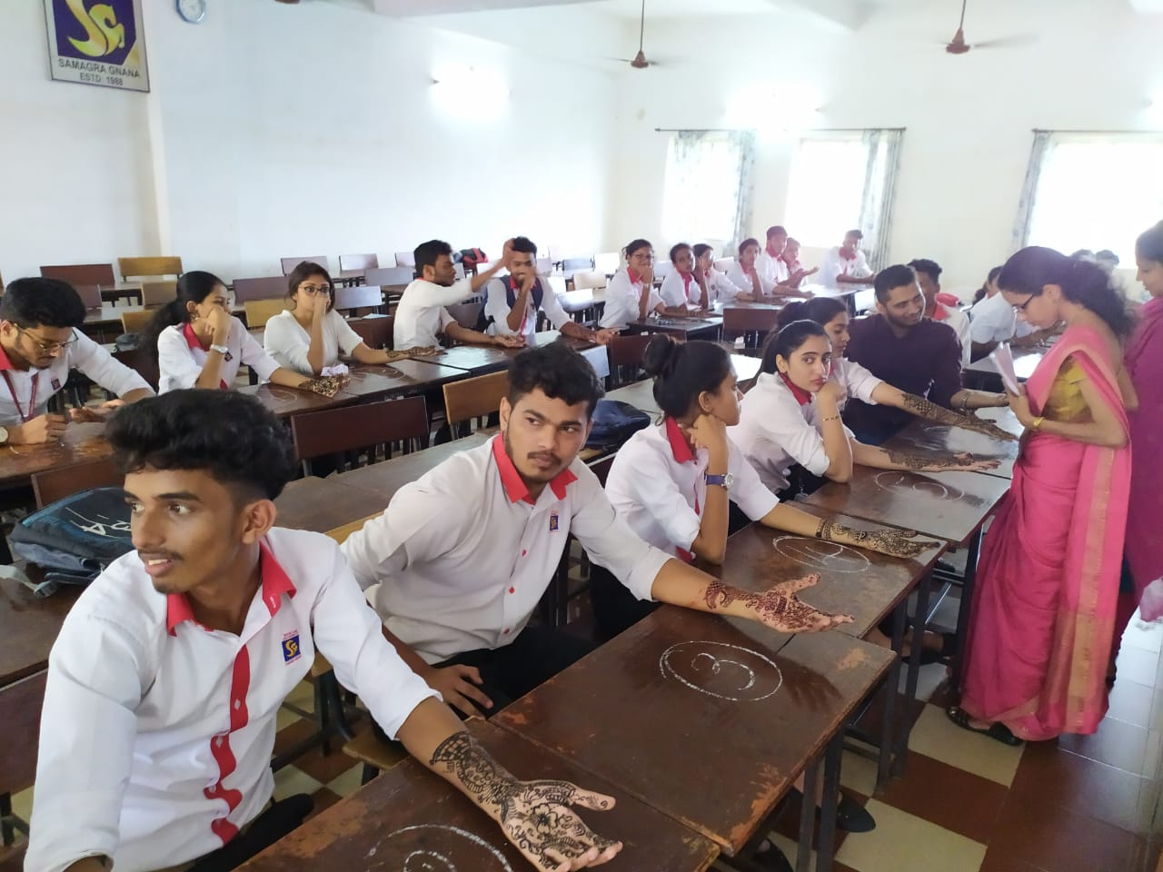
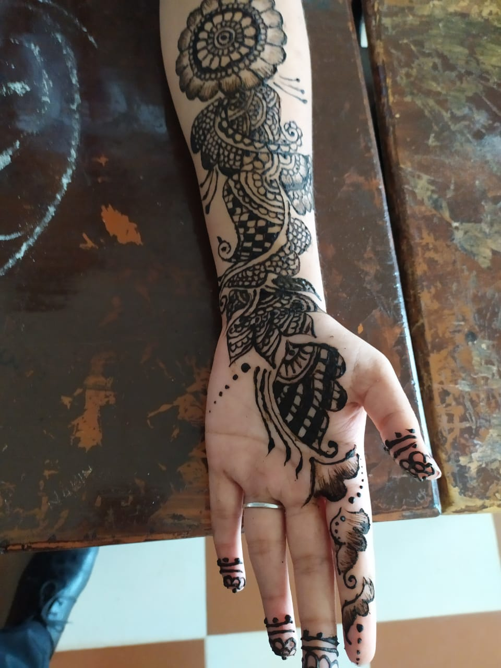

Slide 39
GUESLT LECTURE ON COCKPIT OPERATION OF AIRCRAFT

Slide 40
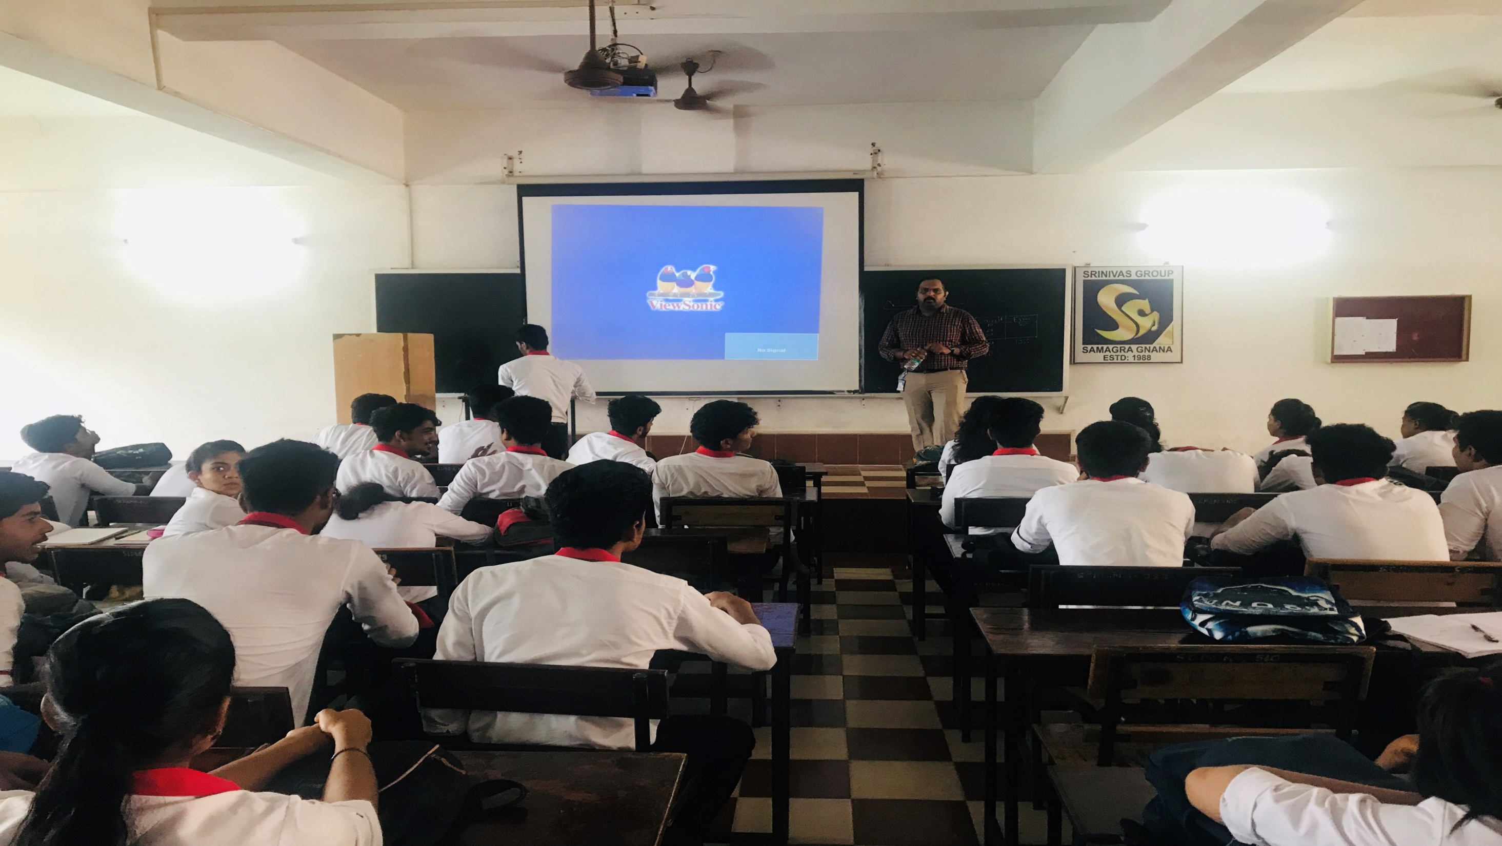

Slide 41
VISIT TO MYSORE AIRPORT BY AVIATION STUDENTS

Slide 46
WINNERS OF NRITYANJALI DANCE COMPETITION

Slide 51
VISIT TO PILIKULA BY FINAL YEAR AVIATION STUDENTS

Slide 53
RED FM TALENT HUNT AT CAMPUS

Slide 54
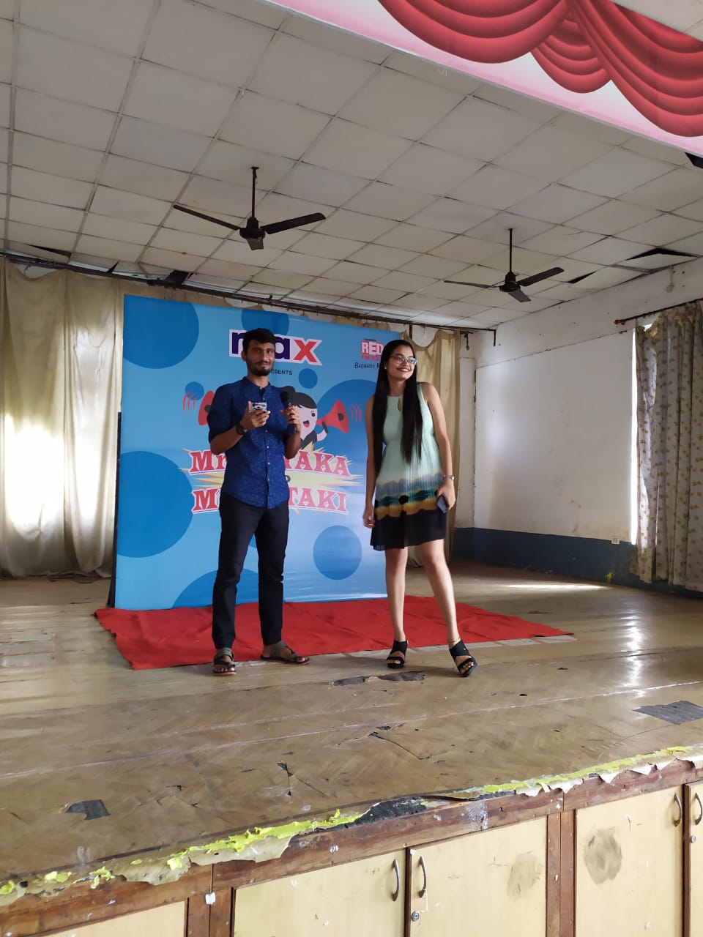

Slide 55
SLOGAN WRITING COMPETITION WINNERS AT AIRPORT-

Slide 56
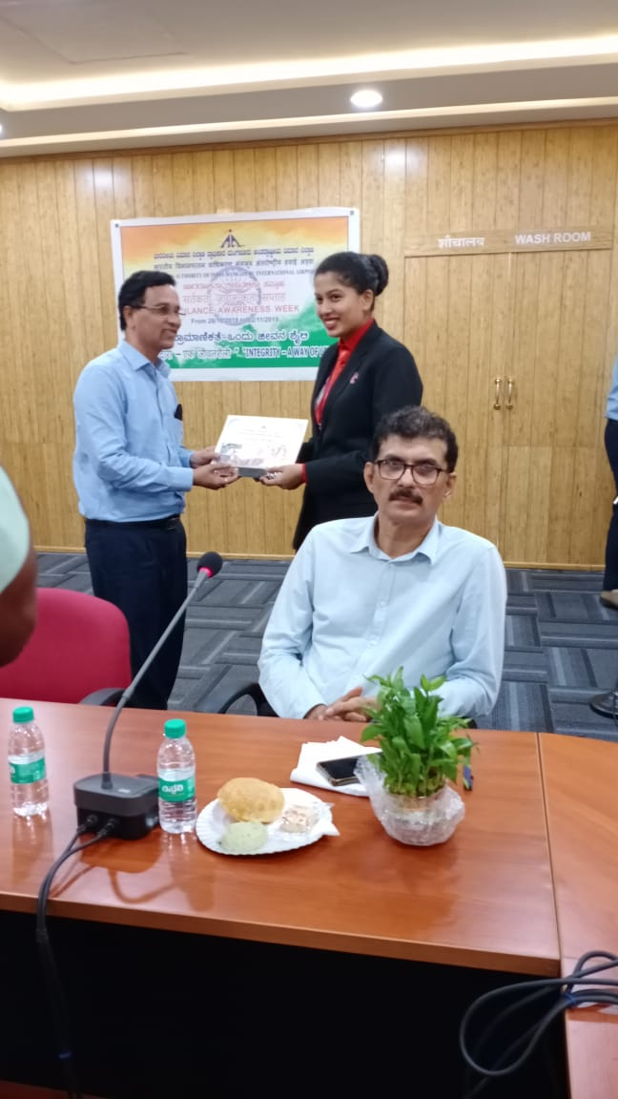

Slide 58
WINNERS OF FACE PAINTING COMPETITION AT AGNEYA 2K19

Slide 59
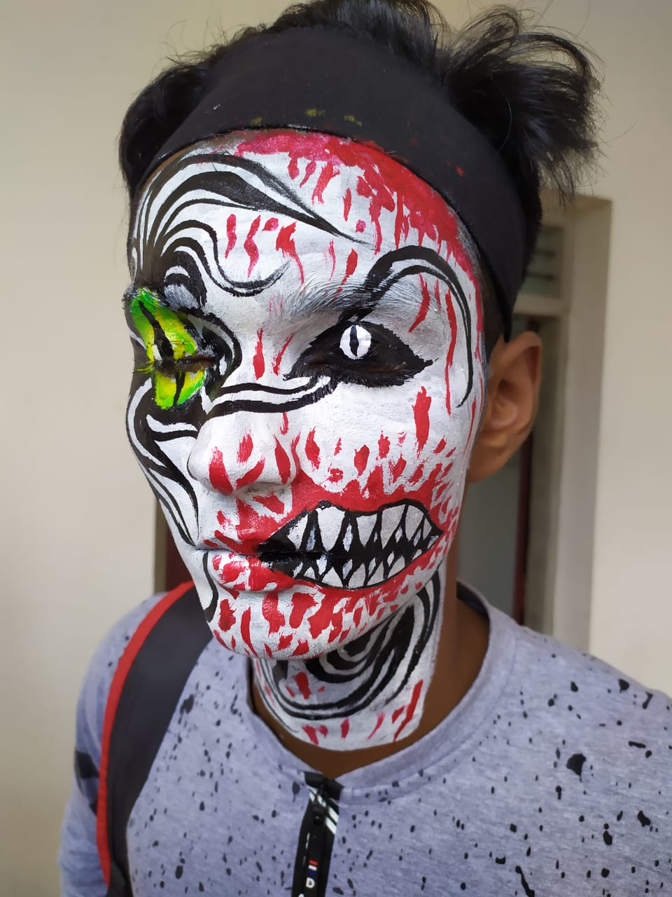

Slide 61
SRINIVAS UNIVERSITY ACQUARIUM MAINTENANCE WORK AT MANGALORE INTERNATIONAL AIRORT

Slide 62
VISIT TO PILIKULA BY FIRST YEAR AVIATION STUDENTS

